Slide 1
Network Slicing Architecture
draft-geng-netslices-architecture-00
Liang Geng (China Mobile)
Stewart Bryant, Jie Dong (Huawei)
IETF98 Network Slicing Chicago 2017

Slide 2
Objective
Recent discussion on netslices@ietf.org indicates network slicing has a broad scope
An initial network slicing architecture may help the discussion converge to several key components
Considerations about the architecture components may help to identify gaps in IETF’s perspective

Slide 3
Demand for Network Slicing
Guaranteed Service Performance
  Guaranteed performance for various services
  Various requirements mapped to physically or logically dedicated resources
  Shared infrastructures to be scalable
  End-to-End Customization
  Agile resource allocation
    Customized service functions, connectivity, computing and , storage resources
  Short Time-To-Market
  Industrial verticals to provide customized services to end users
Notes:
The definition of Service Functions?

Slide 4
Demand for Network Slicing
Network Slicing as a Service
  Networks are more flexible, elastic, modularized and customized
  Dedicated, isolated, end-to-end network resources with a customized topology can be created and managed as a “network slice instance”
  Automatic creation/modification/termination of slices are provided with minimum complexity
  These instances can be provided to tenants/users of the instances as a “service”

Slide 5
Initial Network Slicing Architecture
Basic concepts in network slicing
  Network Slicing Service Provider
    Typically a telecommunication service provider, is the owner of the network infrastructures from which network slices are created.
  Network Slice Instance
    End-to-end realization of network slicing, which consists of the combination of physically or logically dedicated resources (connectivity, computing, storage and certain level of provisioning)
  Network Slice Type
    Presenting a group of network slice instances facilitating services with specific characteristics.
  Network Slice Template
    Model of the resource requirement for network slice instances of a certain type
  Network Slice Tenant
    Users who purchase network slicing services

Slide 6
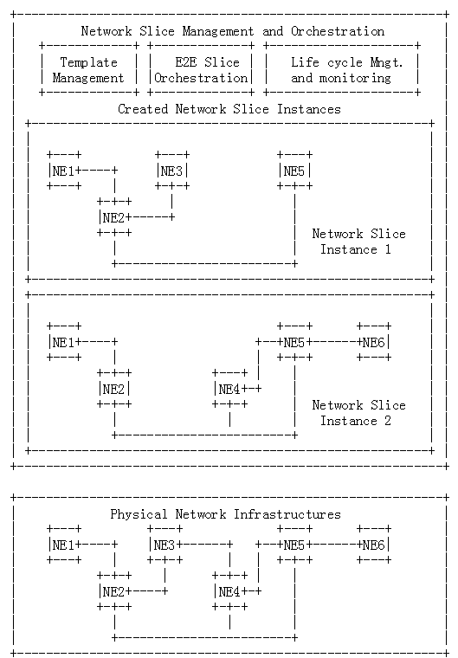
Initial Network Slicing Architecture
NE represents any general network infrastructures
Shared computing, connectivity and storage resources of the NE/NEs
Life cycle management via Network Slice Management and Orchestration system.
  Creation, modification of topology/resources and decommission in a timely manner
  Minimum work done by the network slicing provider or the tenant

Slide 7
Data Plane
Performance guarantee starts from the physical layer, and needs to be maintained by each layer in the protocol stack.
  Technologies such as OTN, FlexE etc. may be candidates for introducing multiplexing whilst maintaining the characteristics of physical network
Hard vs. soft slicing
  Hard slicing provides dedicated resources
  Soft slicing provides separation but allows resource competition
Detnet and network slicing
  The advantage of Detnet in latency guarantee and resource sharing may improve the efficiency of network slicing
VPN and network slicing
  Isolation of forwarding table is considered not enough for hard slicing, pure statistical multiplexing of underlay tunnel cannot meet strict performance requirement

Slide 8
Control Plane
Control plane of the slicing system
  Dynamic creation/modification of network slice in response to service requirements and network changes
  Comply with centralized SDN control
    Flexibility and efficiency
  Keep distributed control protocol for
    Scalability, robustness and fast failure reaction
Control plane in network slice
  Allowing different control protocols to be deployed within individual slices
    OSPF/IS-IS/BGP/SDN controller/etc.

Slide 9
Management and orchestration
E2E slice orchestration
Open ecosystem for new services
Slice template management
Slice lifecycle management
Slice status monitoring

Slide 10
Additonal Components
Service functions and network slicing
  Network slice is the combination of service functions and the required connectivity
  Each NS thus needs dedicated Network, Compute and Storage Resources
  Network needs be aware of services for optimization and coordination
    Although the implementation of service functions may be out of scope
OAM and telemetry
  Measurement and monitoring of network slice is critical for service performance guarantee
  Telemetry is an input steam critical to the dynamic operation of both a slice instance and the slicing system as a whole

Slide 11
Discussion
Is this a good start of network slicing architecture?
Is there anything important missing?
Which part is in/out of scope of IETF?
Detailed work is needed to map existing IETF protocols onto the architecture and to determine the gaps and identify new work required.

